Slide 1
A New Approach to Understanding Systems of Estimation
Paul Garrett¹, David Landy², Joseph Houpt³
& Ami Eidels¹
¹ The University of Newcastle, Australia
² Indiana University, Bloomington
³ Wright State University, Ohio

Slide 2

Estimation
Ability to Quantify large item sets
Fast and Effortless
Low in Accuracy
Quantifies multiple items simultaneously
Notes:
Nearly all animals, and most humans, have the ability to approximate large quantities through a process of estimation. Estimation is characterised by being fast and effortless, low in accuracy and able to quantify multiple items simultaneously.

Slide 3
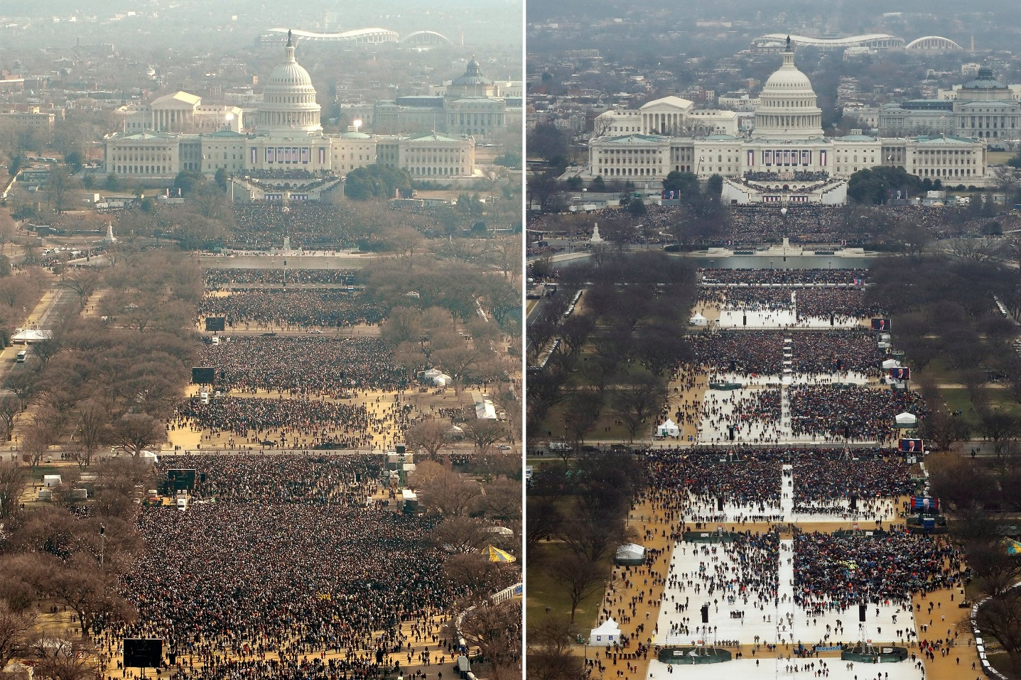
Estimation Systems
Used to quantify and compare two large item sets
e.g. Inauguration Crowds
Ability known to be found in most humans
Notes:
Now when we wish to compare two large quantities, such as Obama and Trump’s inauguration crowds, we do so through an Estimation System.

Slide 4
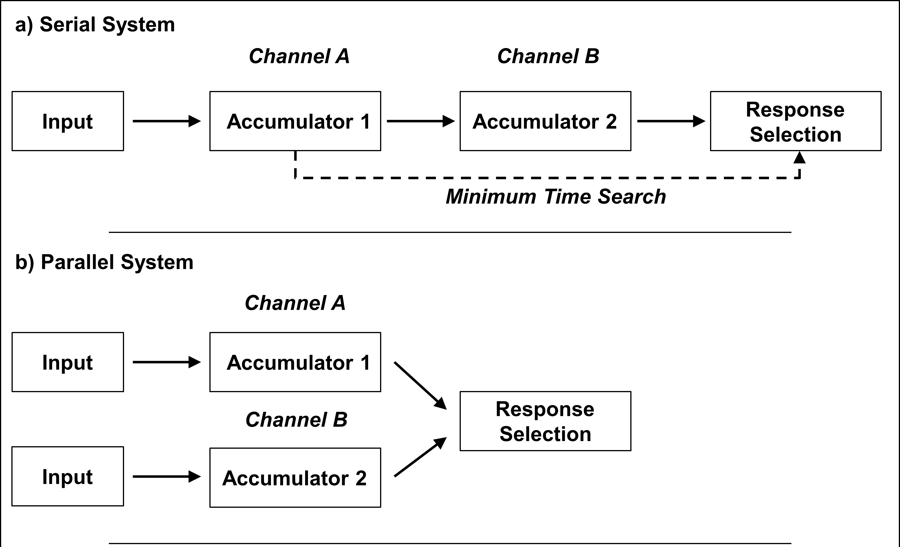
Estimation Systems
Architecture
Parallel vs. Serial
Capacity
Limited – Slows with additional workload
Unlimited – Unaffected by additional workload
Model Mimicry - Unlimited Serial = Limited Parallel mean RT
Notes:
-Typically, we engage systems through one of two Architectures. Serial systems combine information from one source, and then the other. Parallel systems combine information from both sources at the same time.
-Independent from System Architecture is the Systems Workload Capacity. For example, a limited capacity system is slowed by additional workload while an unlimited capacity system is unaffected by additional workload.
-It is important to understand System Architecture and System Capacity, as a fast unlimited capacity serial system is capable of mimicking the mean RT of a limited capacity parallel system. Understanding this brings us back to our systems of Estimation.

Slide 5
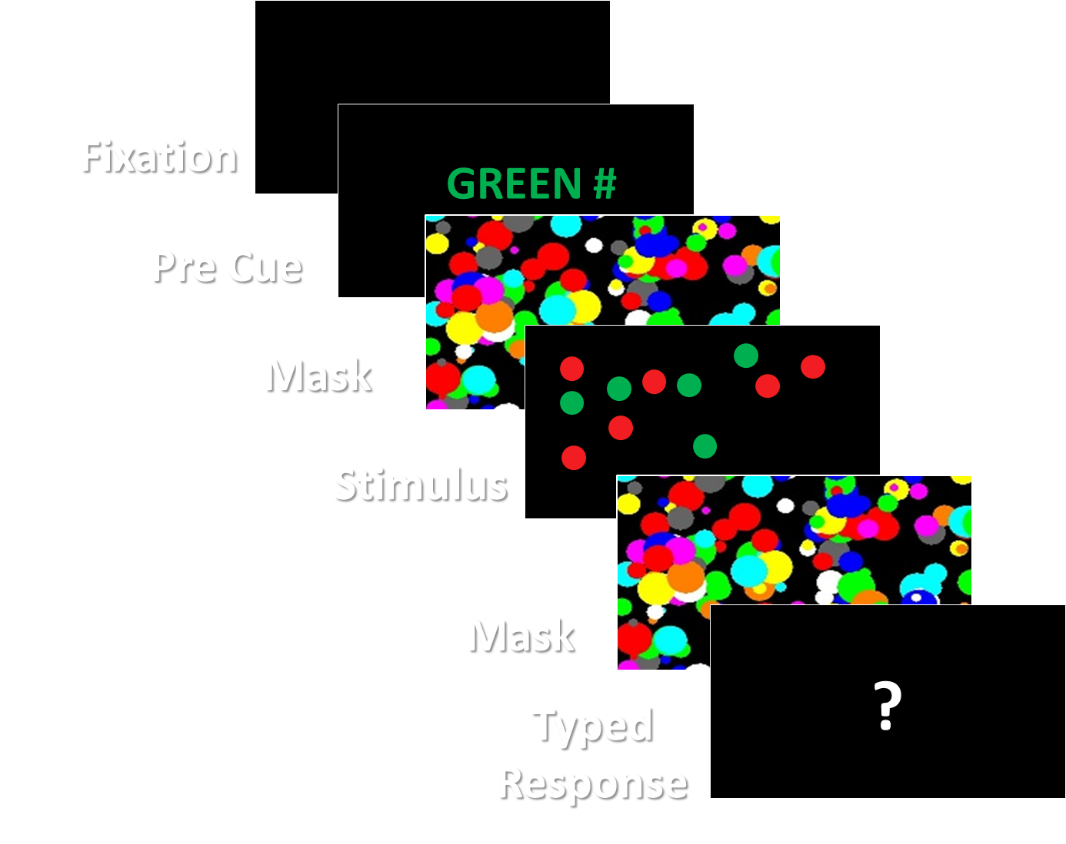
Estimation Systems – Halberda et al. (2006)
Pre Cue Trial
- Compared Pre Cue and Post Cue conditions
No significant difference in Mean RT for Three or Fewer Item Sets
Concluded Parallel Estimation System
Notes:
Before the existence of Alt Facts and Small Handed Presidents, Halberda et al. completed the first study on Estimation Systems. In this study, participants viewed between 1 and 35 dots, which were comprised of 1 to 6 colours. Participants were then asked to estimate the quantity of a cued colour set. These cues were presented either pre or post the stimulus onset. Analysis of Mean RT revealed no significant difference for three or fewer item sets, between pre and post cue conditions. Subsequently, Halberda et al. concluded that up to three item sets could be estimated at any one time through a Parallel Estimation System.

Slide 6
Current Aims
- Directly measure Estimation Systems Capacity
- Directly measure Estimation Systems Architecture
Assess whether differentiating items on the basis of Shared Colour is an Unlimited Capacity Process
Notes:
Now there are three potential problems with this study. Halberda et al. assumed that estimating three item sets was as effortless as estimating one item set. However, they provided no measure of Capacity nor proof of this assumption. As such, my study will aim to directly measure Estimation Systems Capacity.
Given that Halberda et al. used no measure of Capacity and based their interpretations upon mean RT, they also could not reliably diagnose System Architecture. As such, I will also aim to directly measure Estimation Systems Architecture.
Finally, Halberda et al. assumed that differentiating item sets on the basis of shared colour is an unlimited capacity process, an assumption that hasn’t been validated. As such, I will use measures of System Capacity to assess the fidelity of this assumption. Now, in order to fulfil these aims I will be adopting a new approach to understanding Systems of Estimation, an approach that will utilise Systems Factorial Technology.

Slide 7
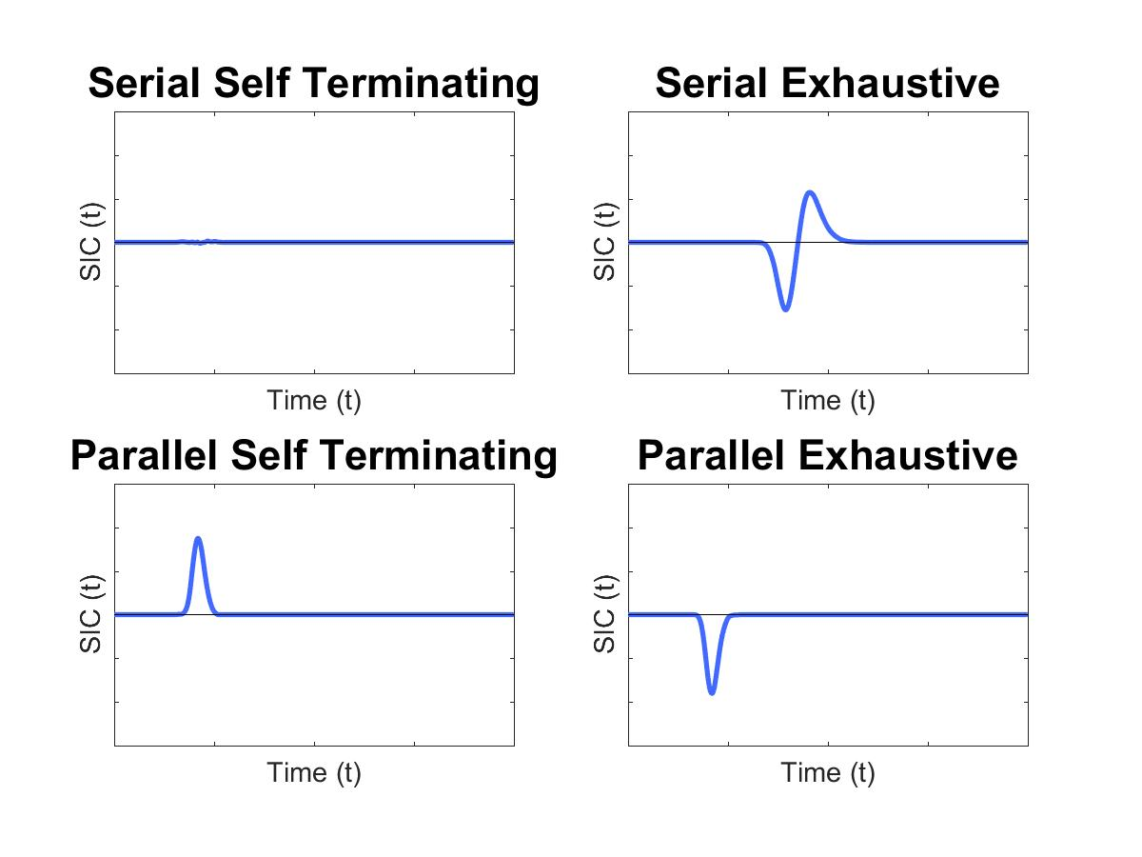
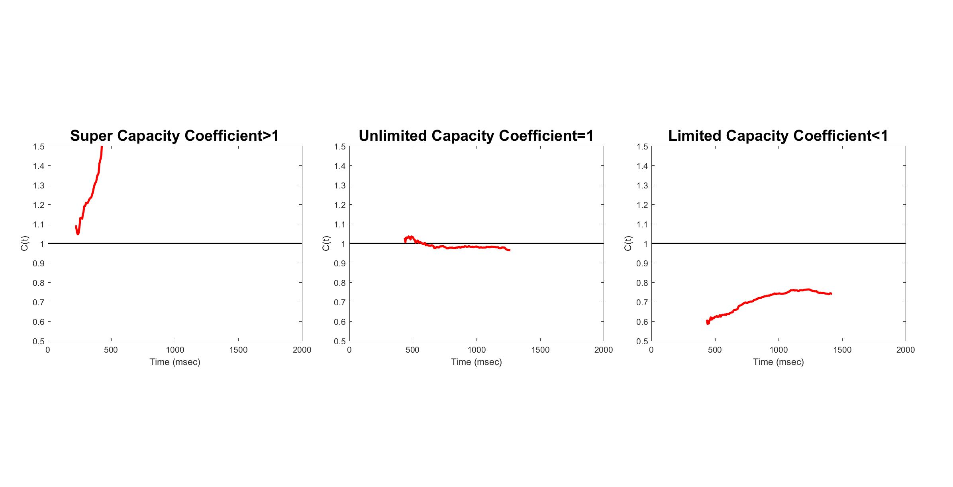
Systems Factorial Technology (SFT)
Compares theoretical process models to models of real RT
Survivor Interaction Contrast –
(Blue) System Architecture
Capacity Coefficient –
(Red) System Capacity
Limited Capacity
C (t)
Time (t)
Unlimited Capacity
C (t)
Time (t)
Notes:
I expect you will hear a lot about SFT in the next few talks so I will be brief. SFT is a nonparametric framework and analysis technique that uses response time distributions to assess System Architecture and Capacity. It does this by comparing theoretical process models to models made using real response time data. For example, you can see here the theoretical models that identify Serial Self-Terminating and Parallel Self-Terminating architectures. These models are generated using one of the tools afforded by SFT, the Survivor Interaction Contrast. On the right, you can see the models that identify Limited and Unlimited Capacity, generated using the Capacity Coefficient. With the addition of statistical tools, these process models will be used to diagnose the properties of Estimation Systems.

Slide 8
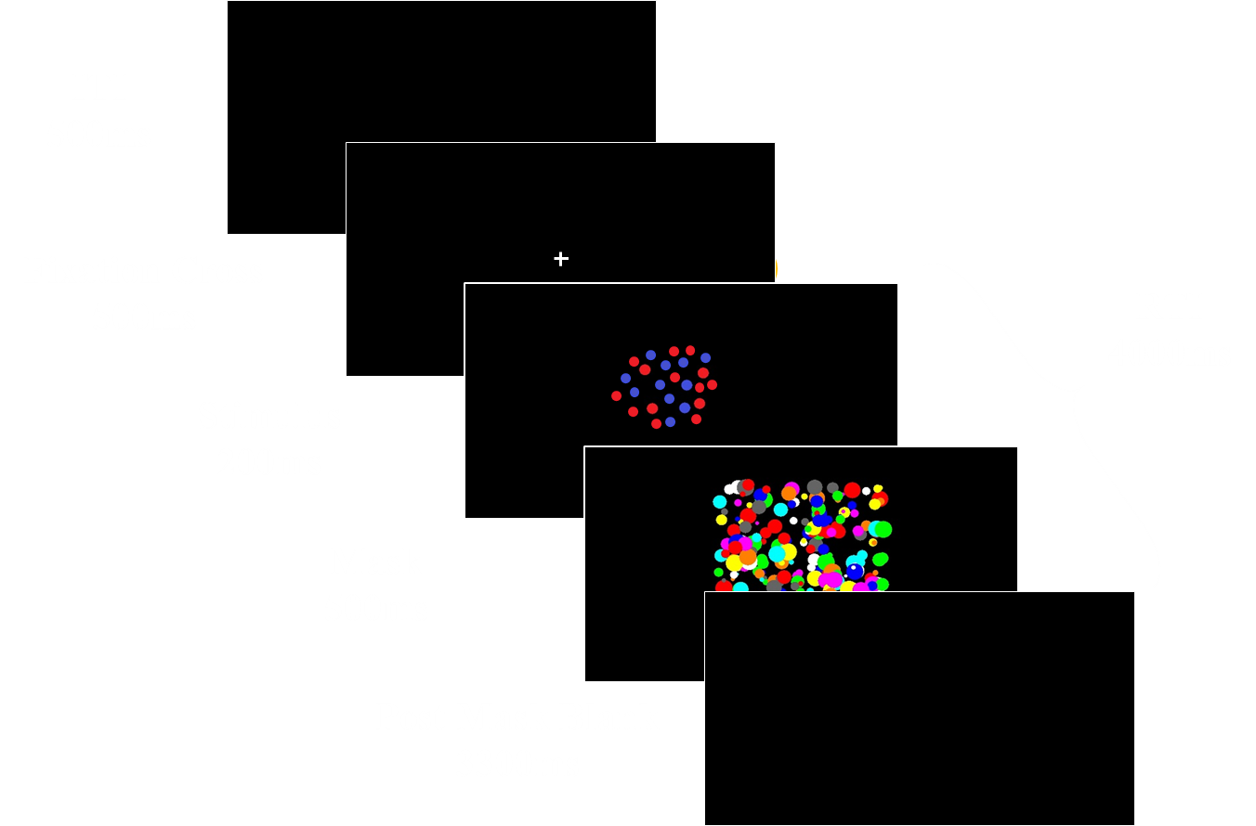


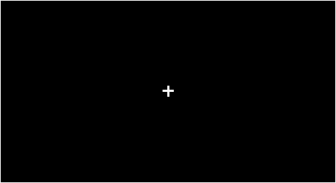
Design
Notes:
Now my proposed methodology is a bit complex, so I will start out with a single trial. On a trial, participants will be asked to decide if either of two colour sets contains less than 20 items? Participants will view a fixation cross, a stimulus comprise of one red and one blue item set and a mask. Participants will have four seconds to respond from the onset of the stimulus with each stim displayed for 200ms.

Slide 9

Design
Target Red
Present
Absent
Target Criterion:
Either set < 20
Example
Stimulus
< 20
< 20
> 20
< 20
Present
Target Blue
Absent
< 20
> 20
> 20
> 20
Notes:
Each stimulus display will be drawn from the illustrated redundant-target double factorial design. The double factorial design is a requirement of SFT, however my design is more complex than most. Simply explained, stimulus displays will consist of either Double-Target item sets where both sets are less than 20 items, Single Target Red item sets, Single Target Blue item sets and No Target item sets. In the absence of a target set, a Distractor set consisting of more than 20 items will be displayed. To overly simplify, the comparison of Double Target and Single Target conditions results our direct measure of System Capacity, the Capacity Coefficient.

Slide 10
Design
Target Red
Present
Absent
Salience Red
Salience Red
High
Low
High
Low
Target Criterion:
Either set < 20
Low Salience 16
High Salience 13
Example
Stimulus
High
13
13
16
13
High
27
13
23
13
Present
Salience Blue
Salience Blue
13
16
16
16
27
16
23
16
Low
Low
Target Blue
Salience Red
Salience Red
High
Low
High
Low
High
13
27
16
27
27
27
23
27
High
Absent
Salience Blue
Salience Blue
13
23
16
23
27
23
23
23
Low
Low
Notes:
Within each of these conditions will be housed a further manipulation of salience. For now, I’ll focus attention towards the double-target condition. Here Salience is defined by proximity to the criterion value. The closer an item set is to 20, the harder it becomes to evaluate. As such, Low Salience Targets will comprise Sixteen items, while easier High Salience Targets will comprise 13 items. Expanding the design, you can see this logic applied across all Target and Distractor conditions. Again, to oversimplify, it is the comparison of Salience Conditions within our Double Target condition that allows for our direct assessment of System Architecture, the Survivor Interaction Contrast.

Slide 11
Design
Equal Size
Equal Area
Equal Density
Intermixed
Colour Set
Properties
Localised
Notes:
Finally, to assess the impact of intermixing item sets colours on System Capacity, I will be using a between subjects-manipulation of item set location. In Condition 1, item set will be intermixed randomly within a circular visual field. In Condition 2, item sets will be localised to top and bottom hemispheres of this visual field. In doing so, we can compare differences in participant Capacity between localised and intermixed colour set conditions. As an aside, I would also like to mention we will complete two additional between subject conditions controlling for item set area and item set density, as is typical of numerical studies.

Slide 12
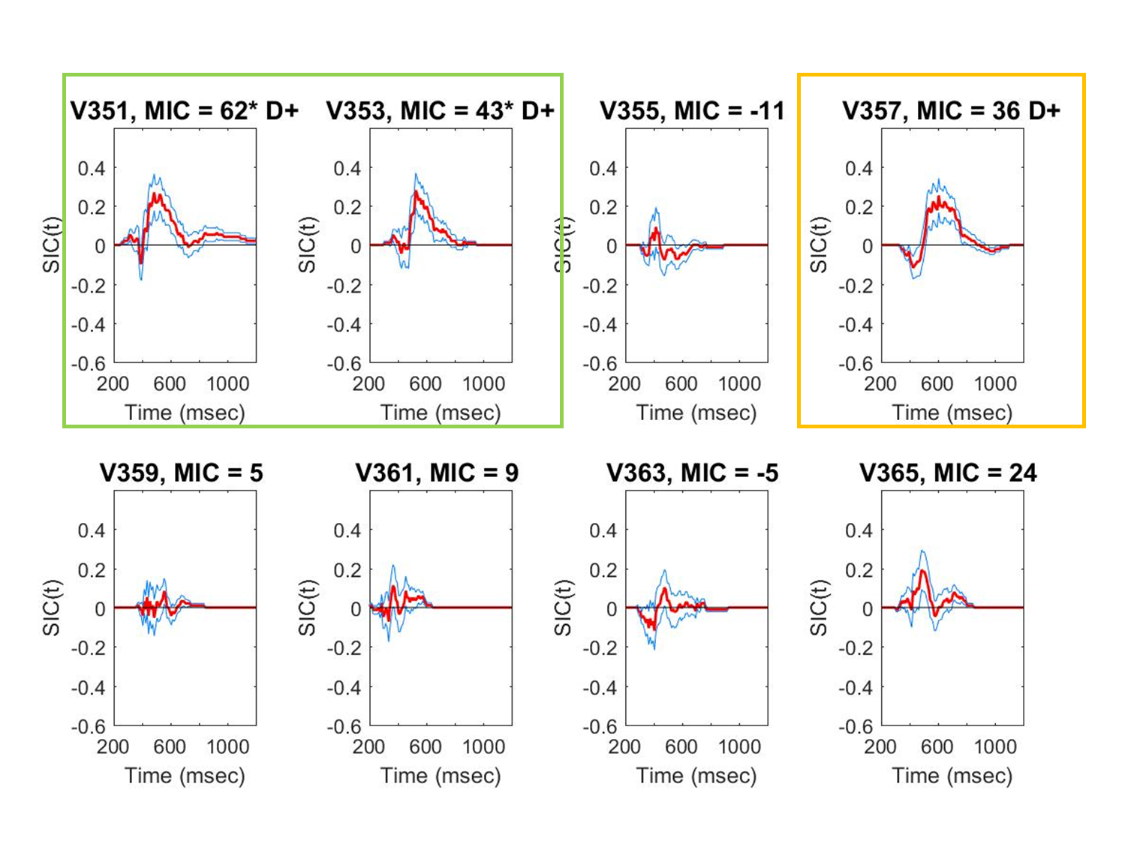
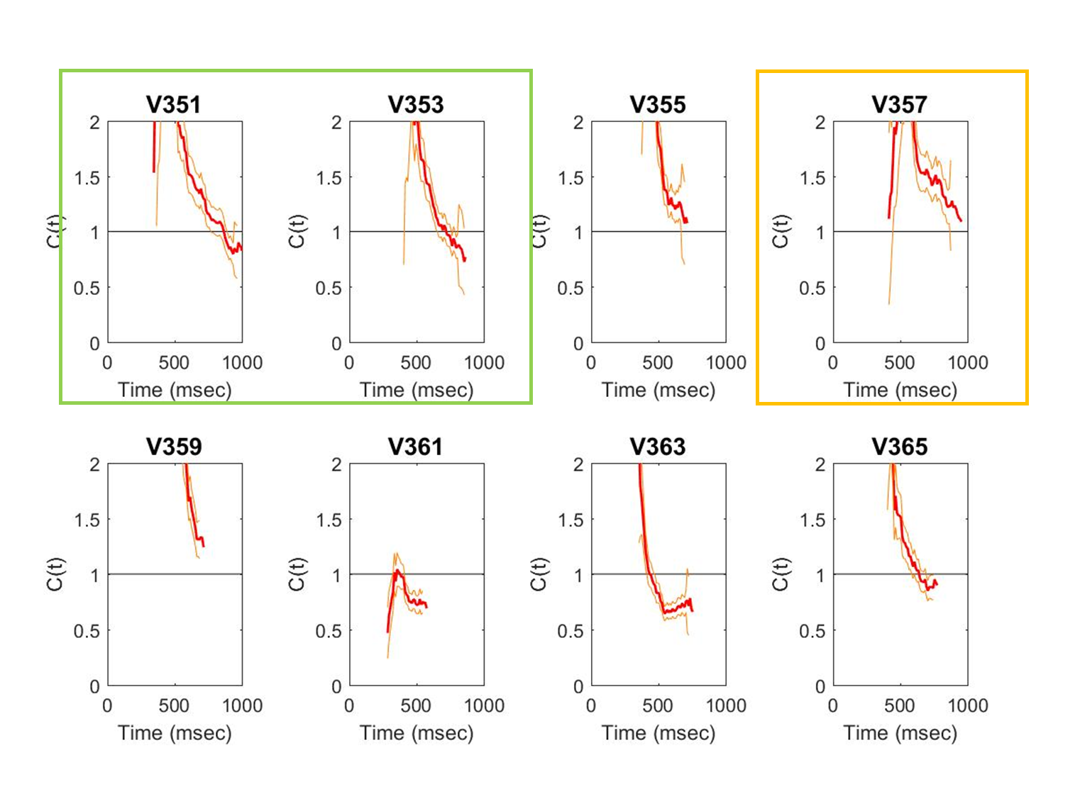
Proof of Concept
Parallel Subitizing
N = 2
RT = 502
Acc = 94%
Serial Subitizing
N = 11
RT 564ms
Acc 95%
Unclassified Parallel = 1
Notes:
Now, up until this point things have been entirely theoretical. However, I would like to put forth a proof of concept. Last year I completed a study investigating Systems of Subitizing. For those who do not know, subitizing is the rapid quantification of 1-4 items and like estimation it occurs in parallel. The details and rational behind this study are different from the current study, however the logic that underpins this Double Factorial Design and Salience Manipulation are exactly the same. And as you can see, results from this study provide very clear Survivor Interaction Contrasts comparable to their theoretical process models. Similarly, we also measured System Capacity and again, we see very clear Capacity Coefficients, indicative of unlimited process capacity. Over the coming months, I plan to build upon this work by applying SFT to Estimation Systems, and in doing so further our understanding of numerical cognition as a whole.

Slide 13
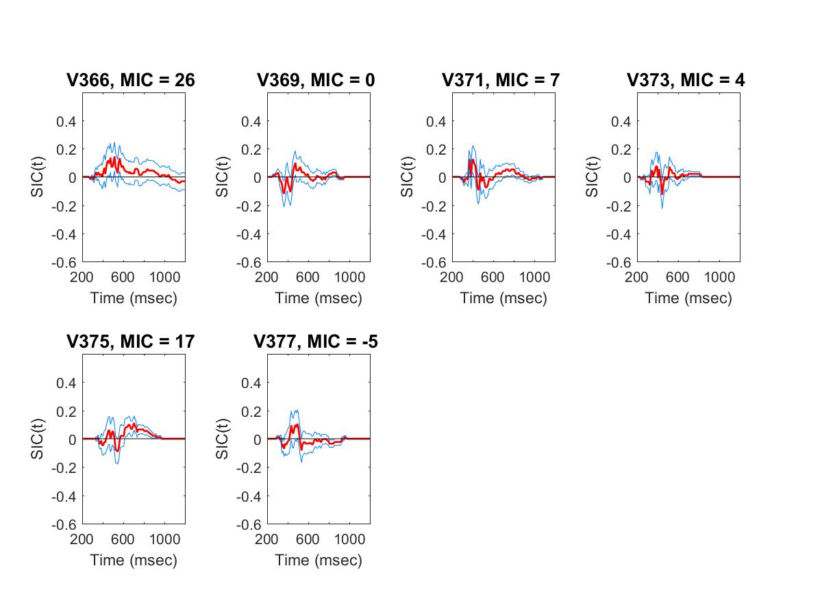
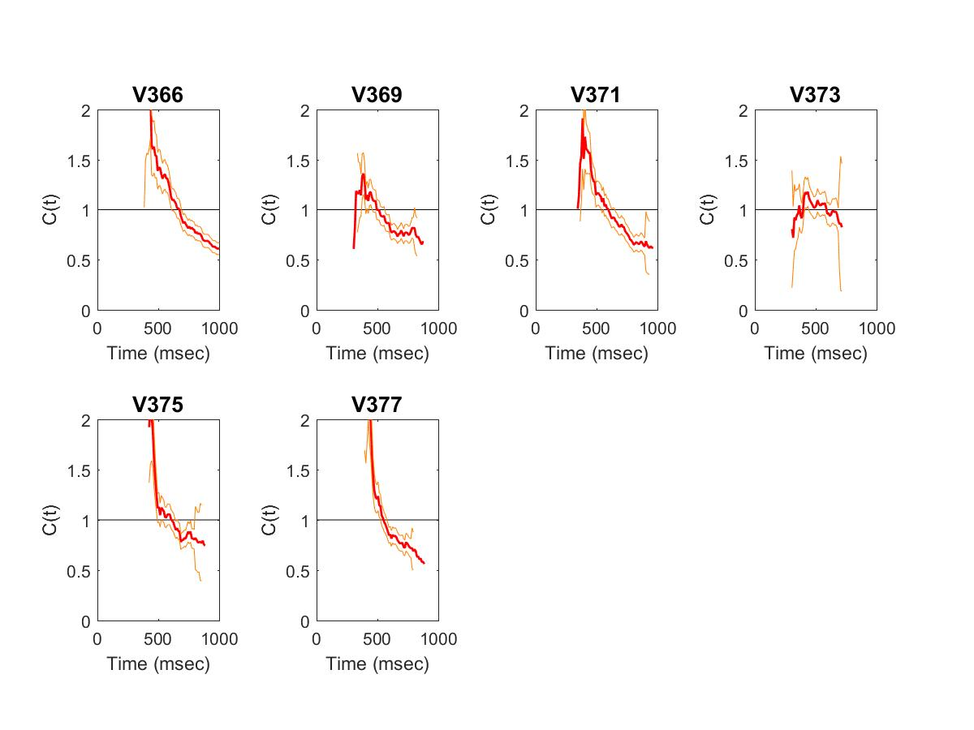
Proof of Concept
Parallel Subitizing
N = 2
RT = 502
Acc = 94%
Serial Subitizing
N = 11
RT 564ms
Acc 95%
Unclassified Parallel = 1

Slide 14
Thankyou

Slide 15


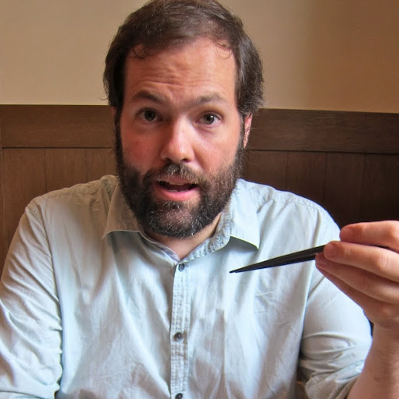
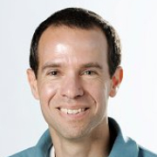


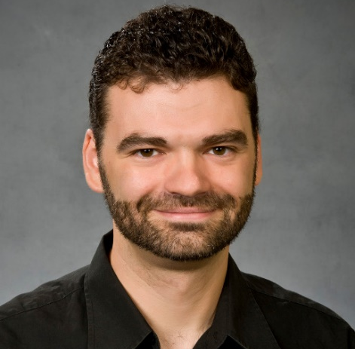
Acknowledgements
David Landy
Ami Eidels
Alex Thorpe
Joe Houpt

Slide 16


Questions?
QUESTIONS? QUESTIONS LOVE ME.
OH YOU WANT TO ASK QUESTIONS?
OK. NOT YOU. OR YOU. NOT YOU. NEXT?
ASK ANYONE. I GIVE THE BEST QUESTIONS

Slide 17
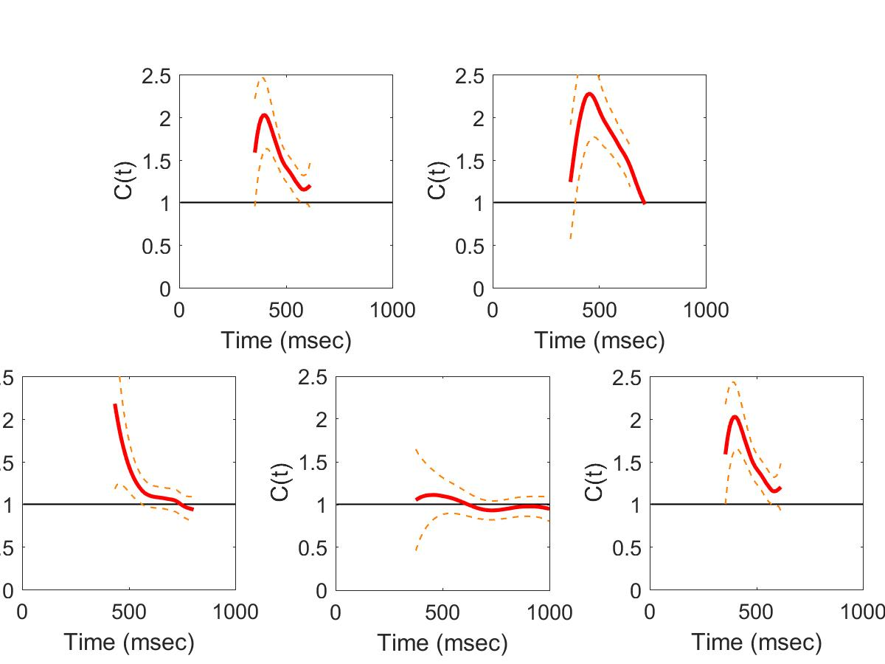
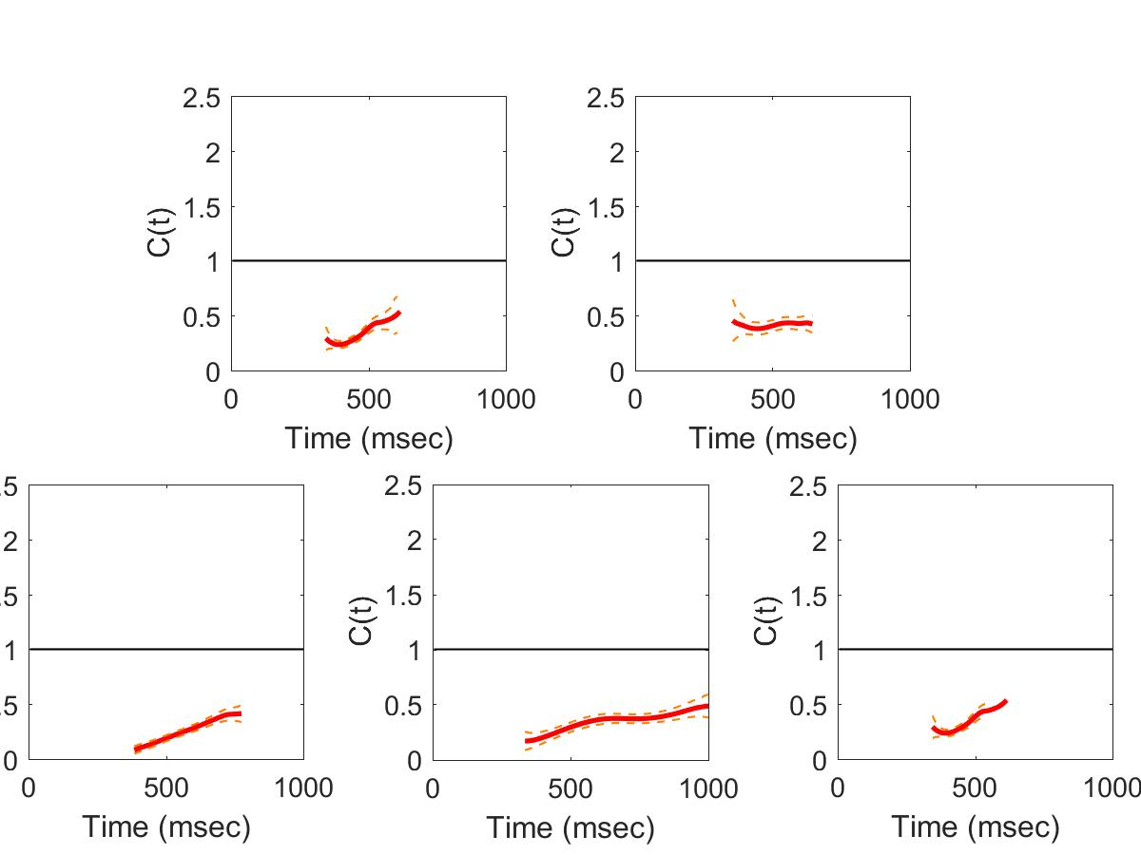
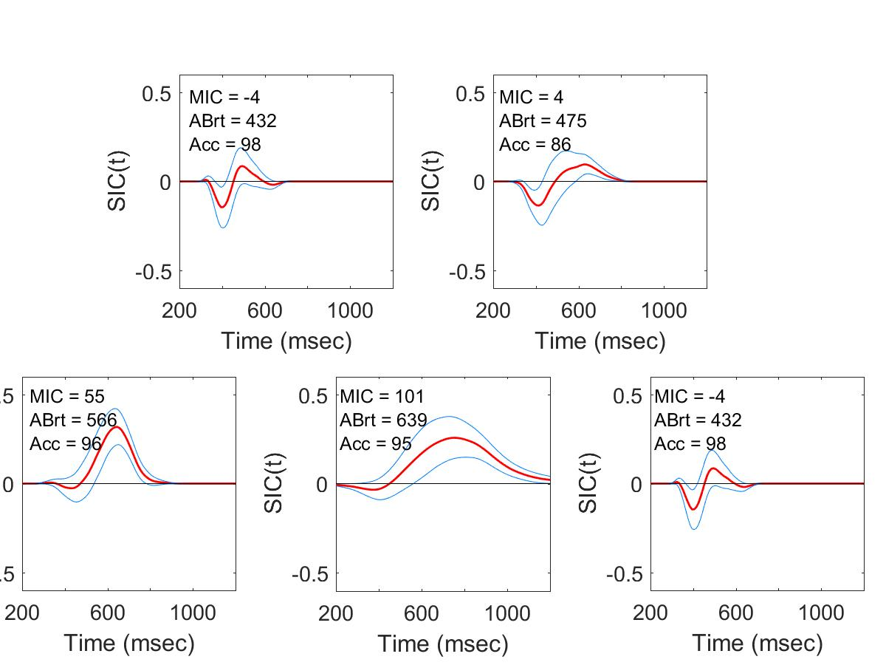

Pure Capacity
Example
Stimulus

